Slide 1


Association between Bilirubin and Survival in Primary Biliary Cirrhosis
By Amelia Tran
Supervisor: Dr. Marie Ozanne
Department of Mathematics and Statistics
Mount Holyoke College
Notes:
Hi everyone, welcome to my thesis defense. My name is Amelia. My project is about the statistical analysis of the association between Bilirubin and survival in primary biliary cirrhosis. I started this project during my internship at MSKCC and continued my work during the school year under the supervision of Dr. Marie Ozanne.

Slide 2
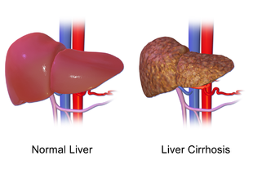
Primary Biliary Cirrhosis (PBC)
Relatively rare disease (1/3000)
Common in women
Symptoms:
Jaundice
Fatigue
Loss of appetite
No symptoms
(Source: Bruce Blaus, Wikimedia Commons)
Immune system attacks liver
Damage bile ducts
Lead to liver fibrosis and cirrhosis
Possibly lead to liver cancer
Treatment:
Medications
Liver transplantation
Notes:
Primary biliary cirrhosis is a chronic liver disease. When someone’s immune system attacks the liver, it causes slow, progressive damage to the bile ducts in the liver. Overtime, it will lead to liver fibrosis and cirrhosis, or even liver cancer. It is a relatively rare disease (1/3000) but very common in women.
Common symptoms of PBC include yellowing of the skin, fatigue, and loss of appetite. Some patients may have no symptoms at all. Possible treatment includes medications and liver transplantation.

Slide 3


Study data - PBC Clinical Trial
Follow-up for 10 years
312 patients: 154 in placebo group
158 in treatment group
Clinical factors: age, drug, sex
Longitudinal biomarkers: Repeatedly measured
at 6 months, one year, and annually thereafter
e.g: serum bilirubin, albumin, prothrombin, platelets, etc.
Outcome: alive/transplanted vs died
Notes:
In this project, the study data is from a PBC clinical trial conducted by the Mayo Clinic for 10 years period. It included 312 patients with 154 in the placebo group and the rest in the treatment group. The dataset has covariates age, drug and sex and longitudinal markers which were repeatedly measured at specified visits at six months, one year, and annually thereafter. The outcome of the patients was alive, had liver transplanted or died.

Slide 4
Research objectives
Measure the association between bilirubin and overall survival among PBC patients
Motivation:
High level of bilirubin causes yellowing of the skin
Help personalize patient care
Better adjust medication for patients
Allocate healthcare resources efficiently
Notes:
The primary aim of this clinical trial was to study the treatment effect of D-penicillin on survival of these patients. My main objective is to study how serum bilirubin is in the association with survival. When the liver fails to excrete bilirubin, high levels of this serum can cause yellowing of the skin, which is a common symptom of cirrhosis. It’s interesting to study this relationship to help personalize the patient care, better adjust the medication, and allocate healthcare resources more efficiently.

Slide 5
Research objectives
Measure the association between bilirubin and overall survival among PBC patients
Use three different statistical approaches in survival analysis
3. Compare the results from three models
Notes:
I do this with three different approaches in survival analysis and compare the results from these models.

Slide 6
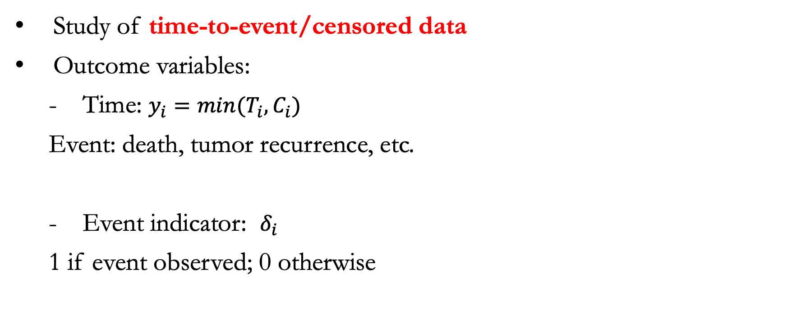
Survival Analysis
id | years | status
1 | 1.09 | dead
2 | 14.15 | alive
3 | 2.78 | dead
4 | 5.27 | dead
5 | 4.12 | transplanted
6 | 6.85 | dead
7 | 6.84 | alive
8 | 6.75 | dead
9 | 6.57 | dead
10 | 0.14 | dead
Study of time-to-event/censored data
Outcome variables:
- Time: $y_{i}=min⁡(T_{i}, C_{i})$
Event: death, tumor recurrence, etc.
Event indicator: $δ_{i}$
1 if event observed; 0 otherwise
Notes:
Survival analysis is the study of time until an event of interest occurs. The outcome variable include time, which can be years, months, or age from the initiation of a study until an event occurs or data is being censored.
An event of interest can be progression of diseases, appearance of tumors, or life failure.
Besides time, there is also an event indicator variable, which is 1 if event is observed, and 0 otherwise.

Slide 7
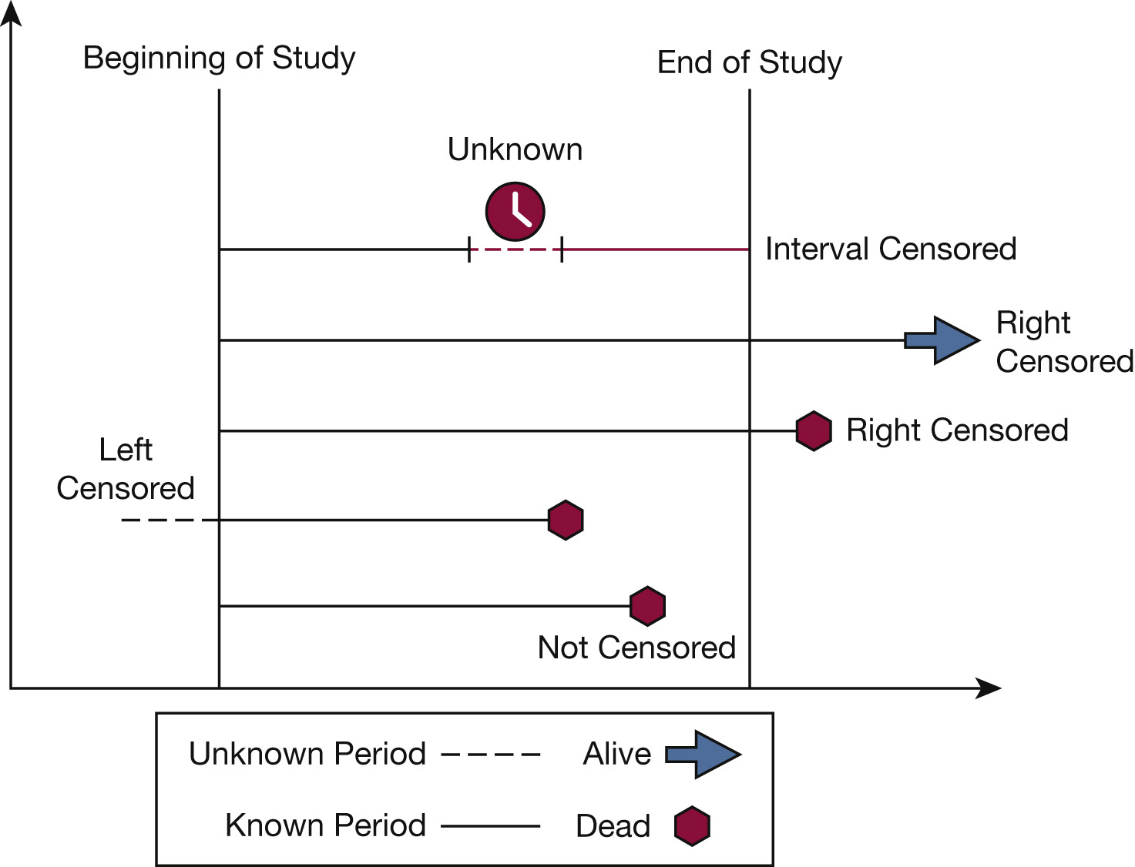
Survival Analysis
Censoring:
- Loss to follow-up
- Withdrawal from study
- Event not observed
Motivation for Cox PH Model
Source: Dey, Tanujit, Anish Mukherjee, and Sounak Chakraborty. Chest 158.1 (2020).
Notes:
In survival analysis censoring happens when the event of interest is not observed. It may be due to loss to follow-ups, withdrawal from the study or event not happening during the observation time. Because of censoring, logistic regression or t-test are not applicable. So it motivates an advanced statistical model: the Cox PH Model. In order to understanding the mathematical setup of the Cox PH model and its extension, i will talk about the key functions in survival analysis.
[[There are different three types of censoring: (1) right censoring - event of interest occurs after a certain time point: a PBC patient was alive at the study termination or lost to follow-up during the study. (2) left censoring - event of interest occurs before a certain time point: a person was followed up until they became HIV positive. The exact time of their first exposure to the virus is unknown; it might have happened before their first recorded positive test. (3) interval censoring - event of interest occurs between a known time interval: an HIV patient tested positive for AIDS. The patient might have developed the disease at some point between their pre-last and last doctor visits]]

Slide 8
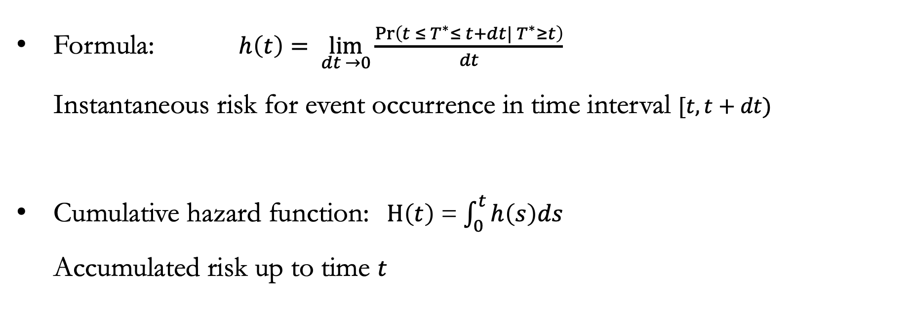
Hazard Function
Formula: $h\left(t\right)= \lim_{dt →0}{\frac{\operatorname{Pr}\left({t ≤ T}^{∗}≤ t+dt|{ T}^{∗}≥t\right)}{dt}}$
Instantaneous risk for event occurrence in time interval $[t, t+dt)$
Cumulative hazard function: $H\left(t\right)$ = $\int_{0}^{t}{h\left(s\right)ds}$
Accumulated risk up to time $t$
Notes:
The first one is the hazard function, which gives the instantaneous risk for occurrence of an event over the time interval [t, t+dt), on the condition that the subject has survived up to time t.
H(t) is the cumulative hazard function that describes the accumulated risk up to time t.

Slide 9
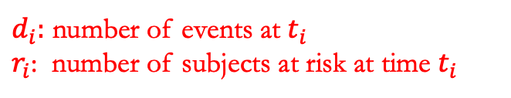
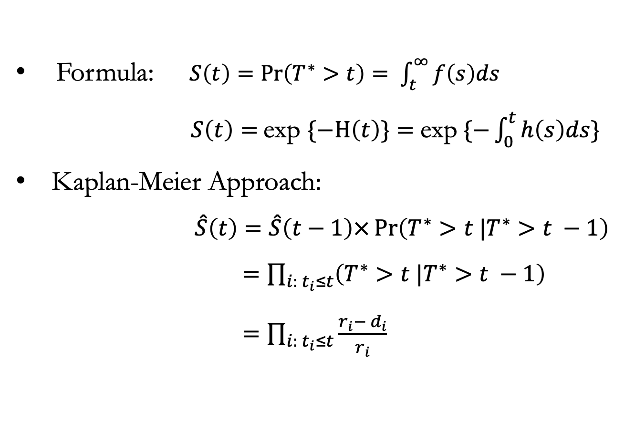
Survival Function
Formula: $S\left(t\right)=\operatorname{Pr}\left(T^{∗}>t\right)= \int_{t}^{∞}{f\left(s\right)ds}$
$S\left(t\right)=$exp $\{−H\left(t\right)\}=$ exp $\{−\int_{0}^{t}{h\left(s\right)ds\}}$
Kaplan-Meier Approach:
$$\hat{S}\left(t\right)=\hat{S}\left(t−1\right)×\operatorname{Pr}\left(T^{∗}>t |T^{∗}>t −1\right)$$
$=\prod_{i: t_{i}≤t}{\left(T^{∗}>t |T^{∗}>t −1\right)}$
$=\prod_{i: t_{i}≤t}{\frac{r_{i}− d_{i}}{r_{i}}}$
$d_{i}:$ number of events at $t_{i}$
$r_{i}$: number of subjects at risk at time $t_{i}$
Notes:
The second key function is the survival function which describes the survival probability past a certain time point t. It is a non-increasing function starting at 1. This is the relationship between the survival function and the cumulative hazard function.
The survival function is used for the Kaplan-Meier approach, which describes survival probability at time t. It is estimated using the Law of Total Probability and is a nonparametric estimator.
Multiplication of proportions of number of subjects not having the event over number of total subjects (after accounting for censoring)

Slide 10
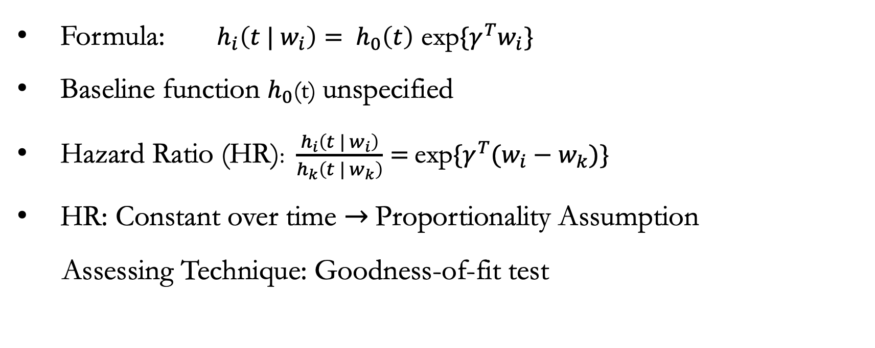
Cox Proportional Hazards Model
Formula: ${h_{i}\left(t | w_{i}\right)= h}_{0}\left(t\right)$ exp$\{γ^{T}w_{i}\}$
Baseline function $h_{0}$(t) unspecified
Hazard Ratio (HR): $\frac{h_{i}\left(t | w_{i}\right)}{h_{k}\left(t | w_{k}\right)}=$exp$\{γ^{T}(w_{i}−w_{k})\}$
HR: Constant over time $→$Proportionality Assumption
Assessing Technique: Goodness-of-fit test
Notes:
The two key functions are the underlying foundation of the Cox PH, the most common statistical approach in survival analysis. It assesses the effects of multiple covariates simultaneously by the hazard function. W denotes the vector of covariates and gamma denotes the vector of corresponding regression coefficients. The baseline function is unspecified to avoid mis-specifying the distribution of survival time.
HR for two subjects at any time t is constant. Hence, it explains the proportionality assumption of Cox model. I use the goodness of fit test to assess the proportionality of the Cox model.

Slide 11
Methods
Cox Proportional Hazard Model
Time-Dependent Cox Model
Joint Model
Notes:
In this project, besides the Cox PH model, I also use the time-dependent Cox model, and Joint Model for longitudinal and survival data to handle censored data. There are differences between these models.

Slide 12
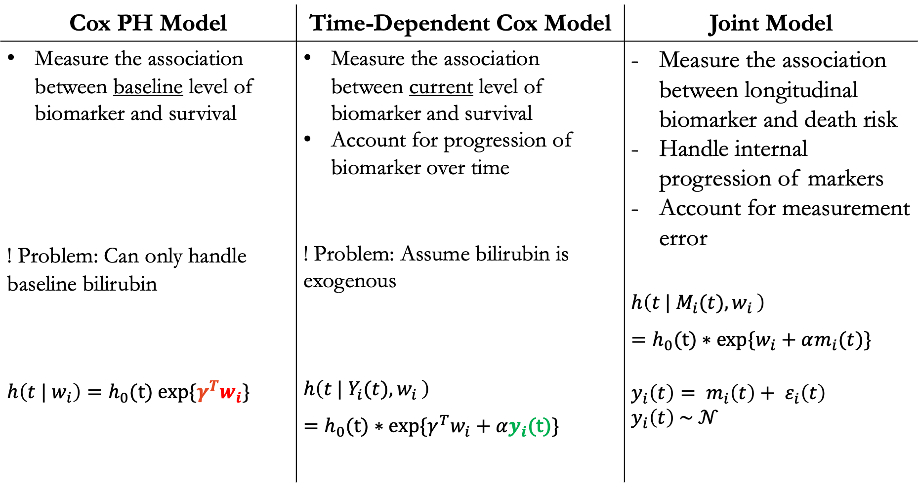
Cox PH Model | Time-Dependent Cox Model | Joint Model
Measure the association between baseline level of biomarker and survival ! Problem: Can only handle baseline bilirubin $h\left(t | w_{i}\right)=h_{0}\text{(}\text{t}\text{) }$exp{$γ^{T}w_{i}\}$ | Measure the association between current level of biomarker and survival Account for progression of biomarker over time ! Problem: Assume bilirubin is exogenous $$h\left(t | Y_{i}(t){,w}_{i}\right)$$ $=h_{0}\text{(}\text{t}\text{) ∗ }$exp$\{{γ^{T}w}_{i}+αy_{i}$(t)} | Measure the association between longitudinal biomarker and death risk Handle internal progression of markers Account for measurement error $$h\left(t | M_{i}(t){,w}_{i}\right)$$ $=h_{0}\text{(}\text{t}\text{) ∗ }$exp$\{w_{i}+αm_{i}(t)\}$ $$y_{i}\left(t\right)= m_{i}\left(t\right)+ ε_{i}\left(t\right)$$ $$y_{i}\left(t\right) \sim 𝒩$$
Notes:
For the Cox PH model, as we have seen from previous slides, it assumes the hazard ratio for two subjects (groups) is constant over time. In other words, Cox PH model only measures the association between the baseline level of biomarker and survival.
However, since the focus of the project involves serum bilirubin, which changes over time. This model cannot accommodate that.

Slide 13
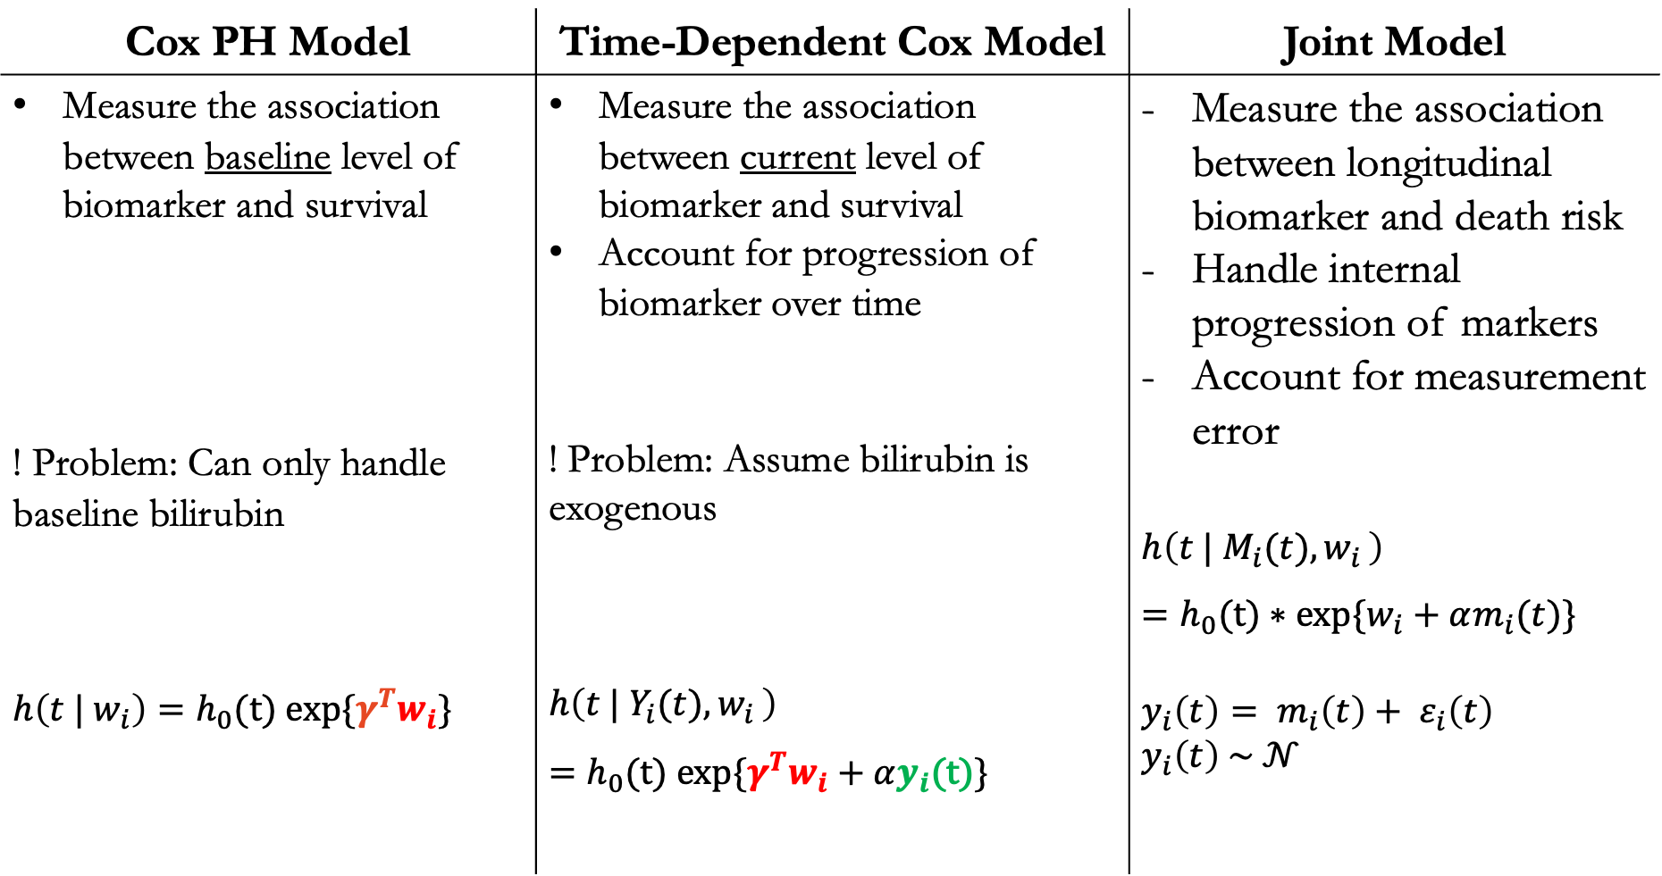
Cox PH Model | Time-Dependent Cox Model | Joint Model
Measure the association between baseline level of biomarker and survival ! Problem: Can only handle baseline bilirubin $h\left(t | w_{i}\right)=h_{0}\text{(}\text{t}\text{) }$exp{$γ^{T}w_{i}\}$ | Measure the association between current level of biomarker and survival Account for progression of biomarker over time ! Problem: Assume bilirubin is exogenous $$h\left(t | Y_{i}(t){,w}_{i}\right)$$ $=h_{0}\text{(}\text{t}\text{) }$exp$\{{γ^{T}w}_{i}+αy_{i}$(t)} | Measure the association between longitudinal biomarker and death risk Handle internal progression of markers Account for measurement error $$h\left(t | M_{i}(t){,w}_{i}\right)$$ $=h_{0}\text{(}\text{t}\text{) ∗ }$exp$\{w_{i}+αm_{i}(t)\}$ $$y_{i}\left(t\right)= m_{i}\left(t\right)+ ε_{i}\left(t\right)$$ $$y_{i}\left(t\right) \sim 𝒩$$
Notes:
Time -dependent Cox model takes into account the progression of longitudinal biomarker. New term yi(t) in the formula is the value of biomarker at time t for subject i. Because of it, this model captures the longitudinal history up to time t. But there’s one problem that it assumes Bilirubin exogenous.
Exogenous covariates are time-dependent but predictable such as age. If we know the age now, we know the age in five years from now and it doesn’t change by the status of patients. However, Bilirubin is endogenous, which means that it is unpredictable. It is generated itself and affected by true failure time. So, we use the 3rd model. Joint Model.

Slide 14
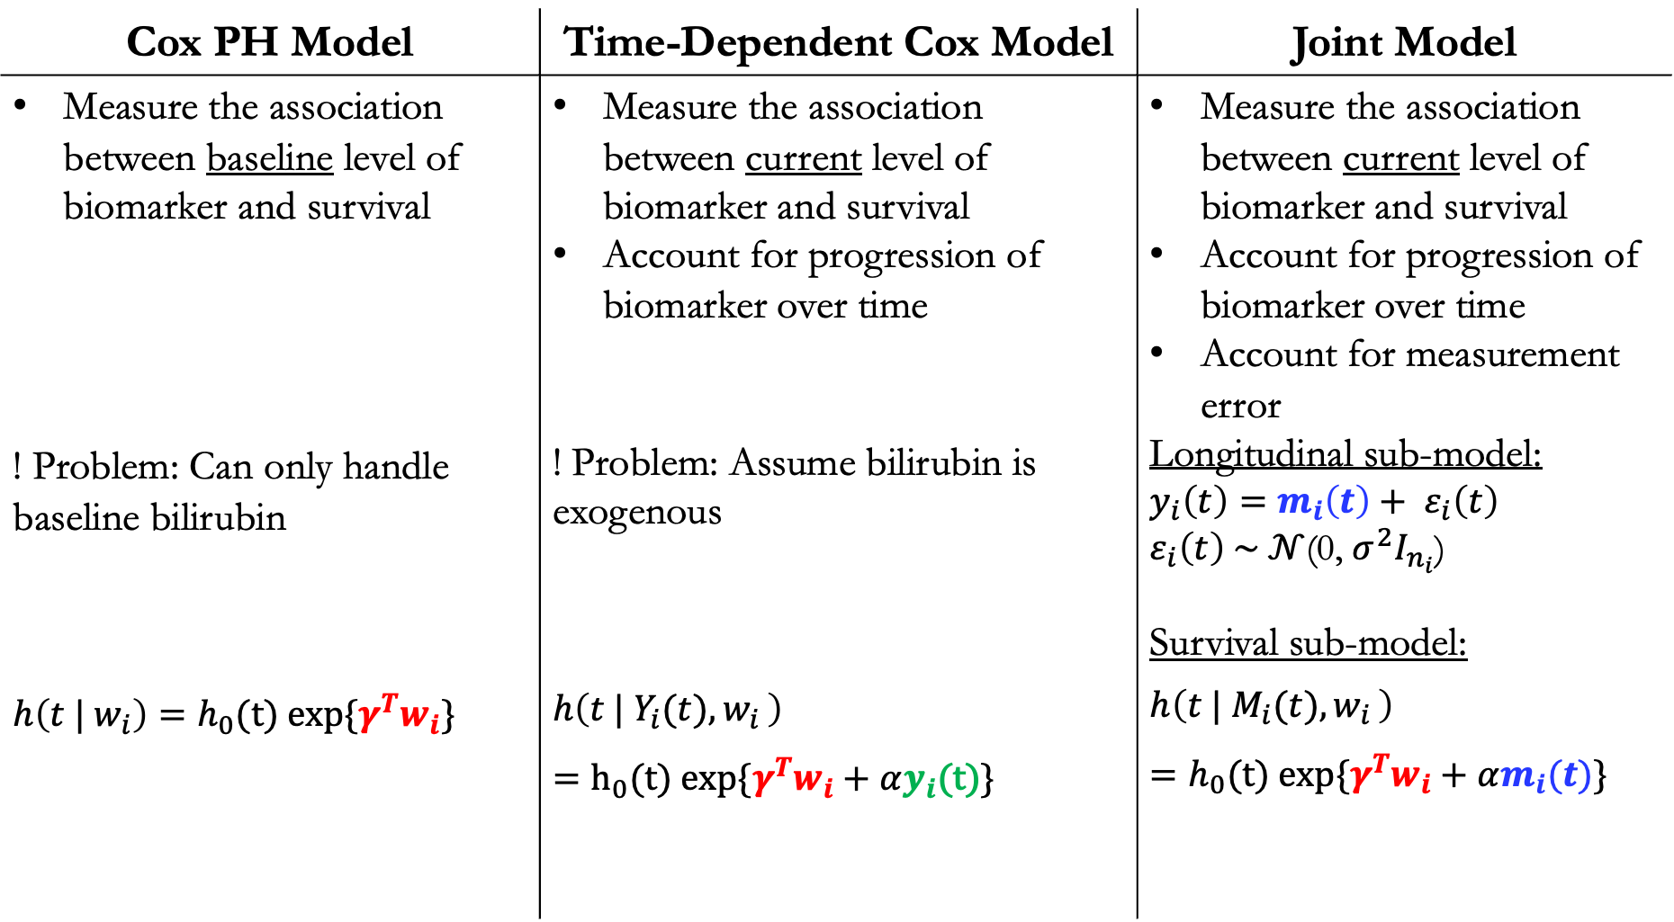
Cox PH Model | Time-Dependent Cox Model | Joint Model
Measure the association between baseline level of biomarker and survival ! Problem: Can only handle baseline bilirubin $h\left(t | w_{i}\right)=h_{0}\text{(}\text{t}\text{) }$exp{$γ^{T}w_{i}\}$ | Measure the association between current level of biomarker and survival Account for progression of biomarker over time ! Problem: Assume bilirubin is exogenous $$h\left(t | Y_{i}(t){,w}_{i}\right)$$ $=h_{0}\text{(}\text{t}\text{) }$exp$\{γ^{T}w_{i}+αy_{i}$(t)} | Measure the association between current level of biomarker and survival Account for progression of biomarker over time Account for measurement error Longitudinal sub-model: $$y_{i}\left(t\right)=m_{i}\left(t\right)+ ε_{i}\left(t\right)$$ $ε_{i}\left(t\right) \sim 𝒩$(0, $σ^{2}I_{n_{i}}$) Survival sub-model: $$h\left(t | M_{i}(t){,w}_{i}\right)$$ $=h_{0}\text{(}\text{t}\text{) }$exp$\{γ^{T}w_{i}+αm_{i}(t)\}$
Notes:
It handles the internal progression of the biomarker by accounting for measurement error which is biological variation induced by the patient.
It has two sub-models. Longitudinal submodel: new term mi(t): true and unobserved value estimated by accounting for the measurement error. Survival submodel: we use m(t) instead of y(t).
These two components are modeled at the same time jointly. That's why we call it Joint Model. These are the differences among the three models

Slide 15
Methodology
Univariate Analysis
Variable Selection
Multivariate Analysis
Each model follows this procedure:
Notes:
The methodology of the project: Each model follows this procedure: I select covariates from the univariate analysis at the significance level of 0.10, do the forward variable selection with those covariates, and choose the ones at significance level of 0.05 to include in the multivariate analysis.
(The forward variable selection is based on the likelihood ratio test)

Slide 16
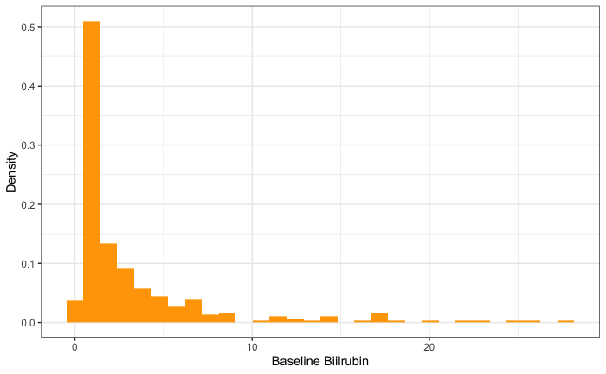
Summary Statistics
Histogram of Baseline Bilirubin
51% in treatment group
Median age: 50 (IQR: 42 – 57)
Sex: 88.5% females
Median baseline bilirubin: 1.4 (IQR: 0.8 – 3.4)
Median follow-up duration: 6.3 years
Patients: 172 alive/transplanted
140 died
Notes:
Dataset at the first glance: The patients were randomized almost equally (with 51% of the patients in) the treatment group and the rest in the placebo group. The median age was 50. The majority of this study was female patients.
The median baseline bilirubin is 1.4 mg/dl (deciliter). The median follow up duration is 6.3 years. At the end of the study, 172 patients were alive or had livers transplanted, the rest died.

Slide 17
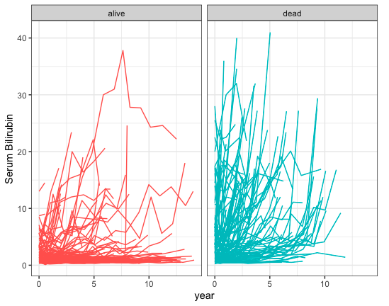
Spaghetti plot of longitudinal bilirubin
Median follow-up duration: 6.3 years
Patients who died seemed to have higher level of bilirubin
Notes:
In this figure, each path represents the longitudinal trajectory of each patient, and they are the levels of bilirubin over time. We can see on the plot, patients who died seem to have higher levels of bilirubin generally.

Slide 18
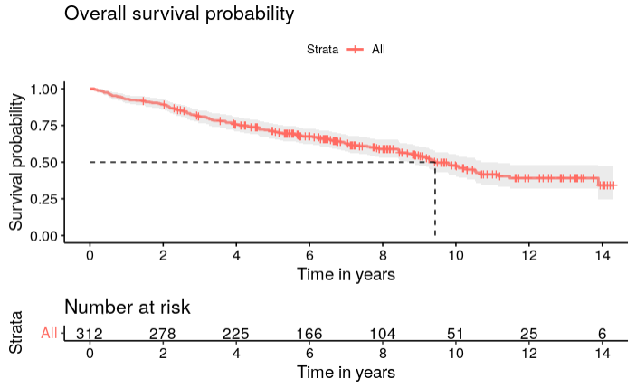
Kaplan-Meier Curve
Tick marks illustrate censoring
at specific time points
Survival decreases over time
Median survival time: 9.5 years
After 6 years: 166 patients at risk
Notes:
I explore the data using Kaplan-Meier curve to visualize the survival probability. The survival starts at 1 at time t = 0 and decreases over time. The tick marks illustrate censoring at specific time points. The time at which the survival probability reaches 0.50 is the median survival time, 9.5 years. After 6 years since the initiation of the study, there were 166 patients at risk.

Slide 19
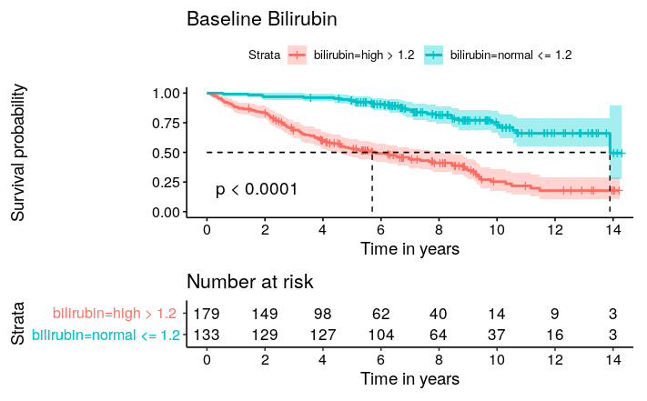
Baseline bilirubin
Log-rank based test for difference
in survivorship between groups
Clinical cutoff: 1.2 mg/dl
Normal baseline bilirubin
High baseline bilirubin
Normal <= 1.2
High > 1.2
Notes:
I use the clinical cutoff 1.2 [ mg/dl (deciliter) ] to classify high and normal levels of bilirubin. From the curve, high bilirubin worsens survival. The small p-value from log-rank based test for group difference also confirms this observation.
(We don't know how high matters. I use it to illustrate survival curves. It’s interesting to look at continuous measurements over time to dichotomize at every time point in the future)

Slide 20
Univariate Analysis for Cox Models
Clinical Factor | Hazard Ratio | 95% Confidence Interval | p-value
Drug | 1.00 | (0.72 – 1.39) | >0.9
Age | 1.05 | (1.03 – 1.06) | <0.001
Sex: male | Ref
female | 0.52 | (0.34 – 0.80) | 0.005
Interpretation:
There’s no treatment effect on the survival
One-year increase in the baseline age is associated with a 5% increase in the hazard of death
Female patients have a 48% lower hazard of death than male patients
Notes:
Now we look at the results from three models we want to compare. We first start out looking at the variables at baseline values to understand the data more.
Since drug is not statistically significant, it is not included in the variable selection.

Slide 21
Univariate Analysis for Cox Models
Biomarker | Hazard Ratio | 95% Confidence Interval | p-value
Albumin | 0.19 | (0.13 – 0.28) | <0.001
Alkaline | 1.00 | (1.00 – 1.00) | 0.094
SGOT | 1.01 | (1.00 – 1.01) | <0.001
Platelets | 1.00 | (0.99 – 1.00) | <0.001
Prothrombin | 2.12 | (1.81 – 2.48) | <0.001
Ascites (No/Yes) | 7.58 | (4.78 – 12.0) | <0.001
Hepatomegaly (No/Yes) | 3.06 | (2.14 – 4.38) | <0.001
Spiders (No/Yes) | 2.42 | (1.72 – 3.42) | <0.001
Edema: No edema | ref |  | <0.001
Edema no diuretics | 1.63 | (1.04 – 2.55)
Edema diuretics | 10.9 | (6.61 – 18.0)
Histologic: 1 | ref |  | <0.001
2 | 6.39 | (0.86 – 47.5)
3 | 9.66 | (1.33 – 70.1)
4 | 24.0 | (3.33 – 174)
Notes:
This is the output with longitudinal biomarkers. Since we’re interested in the association between bilirubin and survival, I use the baseline values for all the other biomarkers. All of them are statistically significant at 0.10 and included in the variable selection.

Slide 22
Univariate Analysis – Serum Bilirubin
Univariate Analysis - Serum Bilirubin
Model | Hazard Ratio | 95% Confidence Interval | p-value
Model 1: Cox PH | 1.16 | (1.13 – 1.19) | <0.001
Model 2: Time-Dependent Cox | 1.16 | (1.14 – 1.18) | <0.001
Model 3: Joint Model | 1.83 | (1.66 - 2.02) | <0.0001
Interpretation:
Model 1(baseline bilirubin): One unit increase in the baseline bilirubin is associated with 16% increase in the death risk
Model 2 (longitudinal bilirubin): One unit increase in the longitudinal bilirubin is associated with 16% increase in the death risk
Model 3 (longitudinal bilirubin & measurement error): One unit increase in the longitudinal bilirubin is associated with 83% increase in the death risk
Notes:
This is the output from univariate analysis for three models with Bilirubin as the only covariate. Cox PH and time-dependent Cox have the same HR. But the Ci for time-dependent Cox is smaller. It’s because I use the bilirubin with repeated measurements and more information reduces the uncertainty.

Slide 23
Multivariate Analysis – Serum Bilirubin
Multivariate Analysis - Serum Bilirubin
Model | Hazard Ratio | 95% Confidence Interval | p-value
Model 1: Cox PH | 1.11 | (1.06 – 1.15) | <0.001
Model 2: Time-Dependent Cox | 1.20 | (1.17 – 1.22) | <0.001
Model 3: Joint Model | 1.82 | (1.64 - 2.03) | <0.0001
High bilirubin worsens survival
Model Adjustment:
Model 1: bilirubin, albumin, age, edema, histologic, SGOT, prothrombin
Model 2: bilirubin, albumin, age, edema, histologic
Model 3: bilirubin, albumin, age, edema
Notes:
This is the output from multivariate analysis. The HR’s are different. But the key point is the same: high bilirubin worsens survival. However, it is important to note that they have different adjusting covariates for each model from the variable selection.
A multivariate analysis is reconducted with the union of those sets of covariates for each of all three models. The differences among estimated hazard ratios for each model are negligible.

Slide 24
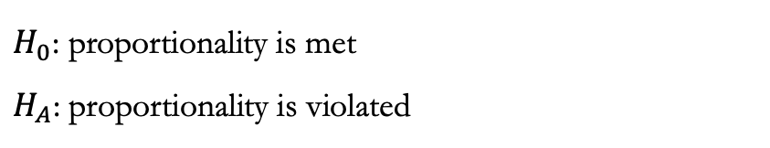
Multivariate Analysis – Proportionality
Cox PH Model
Characteristics | Chisq | df | P-value
Bilirubin | 6.305 | 1 | 0.012
Albumin | 3.043 | 1 | 0.081
Age | 0.195 | 1 | 0.659
Edema | 4.208 | 2 | 0.122
Histologic | 6.603 | 3 | 0.086
SGOT | 0.405 | 1 | 0.525
Prothrombin | 1.482 | 1 | 0.223
GLOBAL | 20.873 | 10 | 0.022
Survival Sub-model of Joint Model
Characteristics | Chisq | df | P-value
Albumin | 2.279 | 1 | 0.131
Age | 0.204 | 1 | 0.651
Edema | 4.848 | 2 | 0.089
GLOBAL | 6.394 | 4 | 0.172
$H_{0}$: proportionality is met
$H_{A}$: proportionality is violated
Notes:
From the goodness-of-fit test in the multivariate analysis, the hazards are not proportional for bilirubin in the Cox PH. It is expected because bilirubin generates itself and each subject has a different longitudinal trajectory over time. But the results from the multivariate Cox PH model are still recorded for comparison, despite a violation.
At the significance level of 0.05, the survival submodel of the Joint Model satisfies the proportionality assumption.
(In the table, each of the p-values checks the assumption for its corresponding covariate under the assumption that the proportionality is satisfied for the other covariates.
Bilirubin is not in the survival submodel because it is monitored in the longitudinal submodel instead. The estimated of the true and unobserved value will be then used in the survival submodel when running the joint model, but from the setup bilirubin does not appear in the survival submodel)

Slide 25
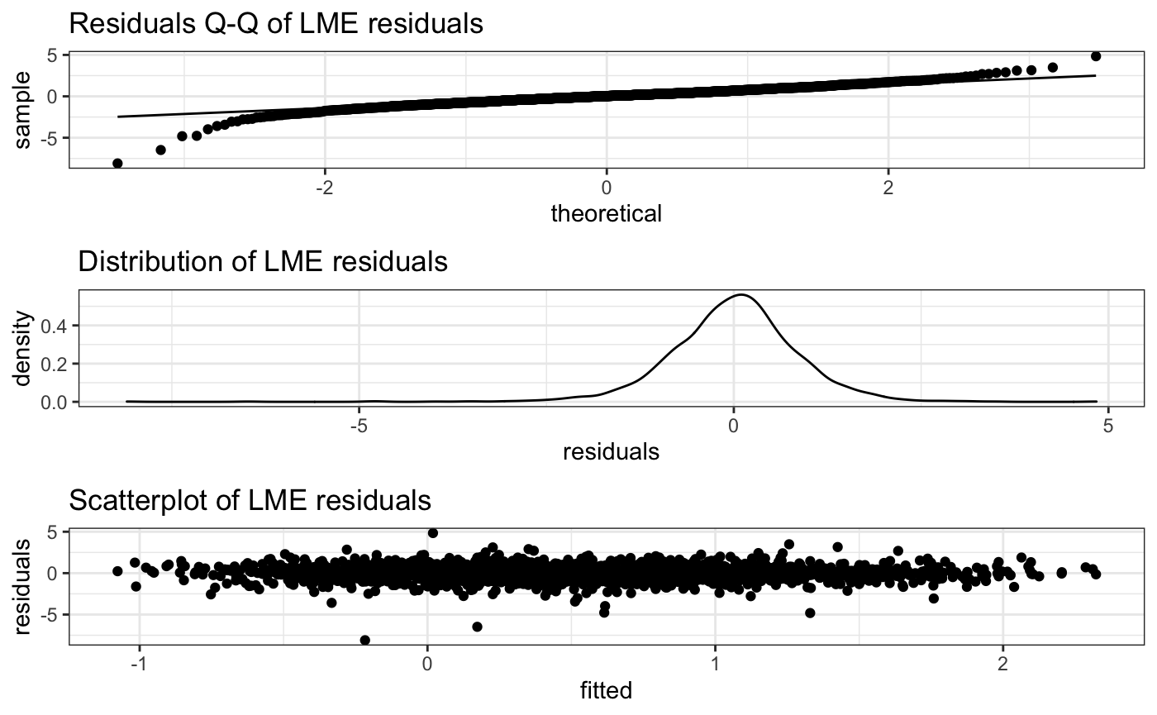
Diagnostic plots for LME
Notes:
The Q-Q plots shows the majority of the points match the straight line. There is no serious outliers or influential observations The distribution of the residuals is approximately normally distributed. The scatterplot of the residuals and the fitted values from the LME shows that there is no specific pattern in the graph.
In general, the diagnostic plots indicate that the underlying assumptions are properly met.

Slide 26
Conclusions
1. Association between bilirubin and survival from Multivariate Analysis:
Cox PH: HR = 1.11, Time-Dependent Cox: HR = 1.20, Joint Model: HR = 1.82
2. Difference in model outputs:
Cox PH: baseline values of bilirubin
Time-Dependent Cox: progression of bilirubin
Joint Model: progression of bilirubin & measurement error
Notes:
In conclusion, I measured the association between bilirubin and survival from three different models. They have different HR's. This is because of the different levels of information considered. Cox PH uses the baseline values of bilirubin. Time-dependent Cox accounts for the progression of bilirubin. And the joint model captures the progression of bilirubin and measurement error.

Slide 27
Conclusions
1. Association between bilirubin and survival from Multivariate Analysis:
Cox PH: HR = 1.11, Time-Dependent Cox: HR = 1.20, Joint Model: HR = 1.82
2. Difference in model outputs:
Cox PH: baseline values of bilirubin
Time-Dependent Cox: progression of bilirubin
Joint Model: progression of bilirubin & measurement error
Notes:
Personally, I prefer the JM because it accommodates what the other two Cox models are unable to.

Slide 28
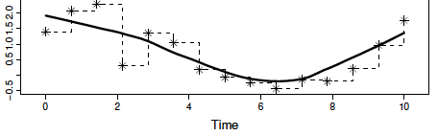

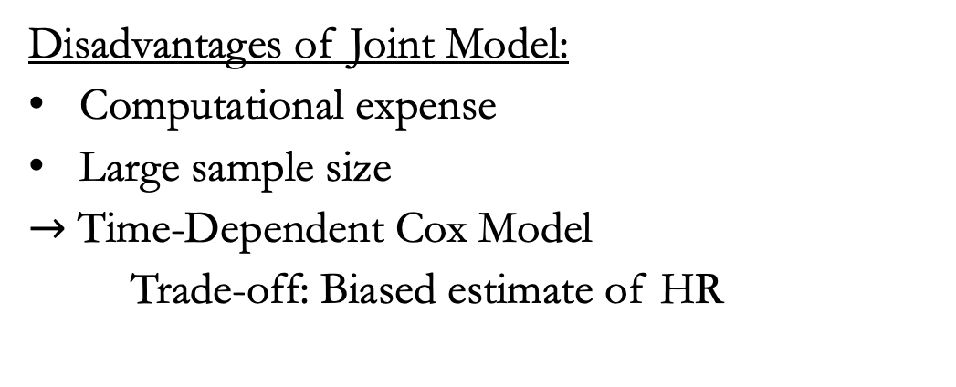
Discussion
Time-Dependent Cox
Advantages of Joint Model:
Smooth longitudinal trajectory
Reduce potential bias
Joint Model
Disadvantages of Joint Model:
Computational expense
Large sample size
$→$ Time-Dependent Cox Model
Trade-off: Biased estimate of HR
Source: Joint Models (Rizopoulos, 2012)
Notes:
Even though JM is the most optimal approach, there are benefits and drawbacks of using the Joint Model. Imagine that this is bilirubin measured repeatedly over 10 years. Time-dependent Cox assumes it to remain constant in the time interval in between the visits. Time-dependent Cox has a step function for longitudinal trajectory. This may result in very biased parameter estimates. The JM uses the true value of bilirubin by including the measurement error. The longitudinal trajectory is much smoother, which reduce bias.
The disadvantages are that this model is very complex and has many parameters p to estimate. It also requires a large sample size to avoid convergence issues. When these conditions are not met, it’s recommended to use a time-dependent Cox model. The trade-off is that HR estimates can be less accurate.

Slide 29
Discussion
Model Adjustment:
Model 1: bilirubin, albumin, age, edema, histologic, SGOT, prothrombin
Model 2: bilirubin, albumin, age, edema, histologic
Model 3: bilirubin, albumin, age, edema
Explanation:
Baseline SGOT and prothrombin not informative to the association in Model 2
Baseline SGOT and prothrombin significant in the longitudinal generating process of bilirubin in Model 3
*Model 1: Cox PH; Model 2: Time-Dependent Cox; Model 3: Survival sub-model
Notes:
(SGOT, is an enzyme normally present in blood at low levels. Prothrombin is a protein produced by the liver. In the PBC dataset, covariate prothrombin is Prothrombin Time (PT) which is the time it takes blood to clot. Increased SGOT and PT may indicate liver damage.)
Baseline measurements of SGOT and prothrombin may not add more information to the investigated association between longitudinal bilirubin and overall survival. Baseline SGOT and prothrombin are statistically significant in the LME. SGOT, and prothrombin are informative to the longitudinal generating process of bilirubin.
I reconducted the multivariate analysis using the union of those sets of covariates for each of all three models. The differences among estimated hazard ratios for each model are negligible.

Slide 30
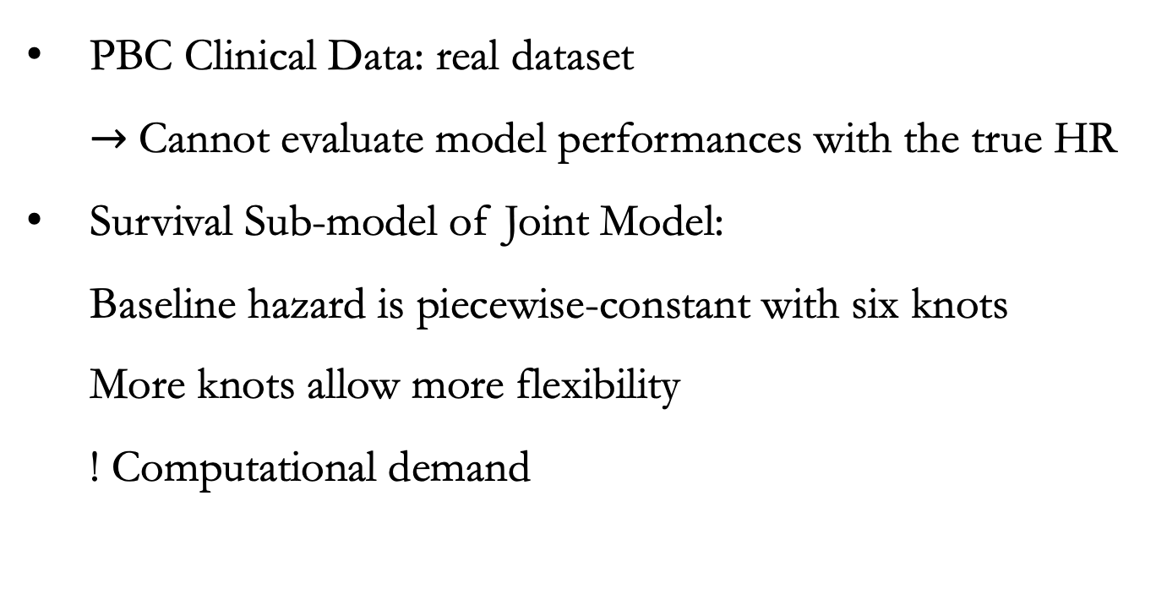
Limitations
PBC Clinical Data: real dataset
$→$Cannot evaluate model performances with the true HR
Survival Sub-model of Joint Model:
Baseline hazard is piecewise-constant with six knots
More knots allow more flexibility
! Computational demand
Notes:
The increasing number of internal knots allows more flexibility and thus captures various shapes of the baseline function. Given the computational demand already in the Joint Model, extra computation to estimate the knots is infeasible.
Similarly, theoretically it is possible to have interaction or polynomial terms in the JM, it is not feasible for the same reason.

Slide 31
Future Work
Simulation with predetermined censoring and hazard rate to estimate the bias
Variable selection with BIC or AIC
Multiple imputation method for missing data
Competing Risk Analysis (alive vs transplanted)
Joint Model for more than one longitudinal biomarker
Notes:
In this project, I use X2 likelihood ratio test for variable selection. It is also possible to use Akaike Information Criterion (AIC) and Bayesian Information Criterion (BIC) in survival analysis, where the penalty term is defined in terms of the uncensored events, instead of the number of observations.
For simplicity, I use the last values carried forward to impute missing data, but we can also try multiple imputation method,. The method is complicated, and the computation is expensive.
Other ways to extend the work are to use competing risks to correctly separate the alive and transplanted events, or to use JM for more than one longitudinal biomarker.
(Elastic net or LASSO regularization is not appropriate for this PBC clinical data set because this is not a high dimensional setting where elastic net or LASSO is used to obtain a parsimonious model. Usually, penalized Cox is utilized to remove the redundant covariates in genomic data which is of high-dimension.
Weibull, exponential, or lognormal distribution though generally, simulation studies showed that even if the correct distribution can be parametrically specified, the Cox models (semi) typically give results approximately close to those obtained from the parametric model for censored data.
There are other options with the same purpose to introduce more flexibility for the longitudinal trajectories of the markers such as ).
it is also possible to try multiple imputation methods for missing data. The procedure is to impute the missing data multiple times by injecting appropriate random variability, perform desired data analysis on the complete imputed data, and average the parameter estimates across samples to obtain a single point estimate. Multiple imputation methods are more complicated, but the computation is often expensive and requires a large sample size.

Slide 32


Acknowledgements
Supervisor: Dr. Marie Ozanne
Mentor: Dr. Audrey Mauguen
QSURE faculties: Drs. Kay See Tan and Margaret Du
Math/Stat Department, MHC
Biostat/Epi Department, MSKCC

Slide 33
Selected References
Rizopoulos, Dimitris. Joint models for longitudinal and time-to-event data: With applications in R. CRC press, 2012.
Kleinbaum, D. G. and Klein, M. (2010), Survival analysis, Springer.
Schober, Patrick, and Thomas R. Vetter. "Survival analysis and interpretation of time-to-event data: the tortoise and the hare." Anesthesia and analgesia 127.3 (2018): 792.
Albert, Paul S. "Longitudinal data analysis (repeated measures) in clinical trials." Statistics in medicine 18.13 (1999): 1707-1732.
Harrell Jr, Frank E., Kerry L. Lee, and Daniel B. Mark. "Multivariable prognostic models: issues in developing models, evaluating assumptions and adequacy, and measuring and reducing errors." Statistics in medicine 15.4 (1996): 361-387.

Slide 34
Thank you! Any question?

Slide 35
Supplementary slides

Slide 36
Assessing Proportionality
Log-log survival curves
Time-covariate interaction
Goodness-of-fit test
Notes:
If the assumption is violated, the estimates are biased and invalid. Thus, it is crucial to assess the proportionality. There are three common ways to assess it:
• Graphics with survival curves
• time-covariate interaction terms
• Goodness-of-fit test

Slide 37
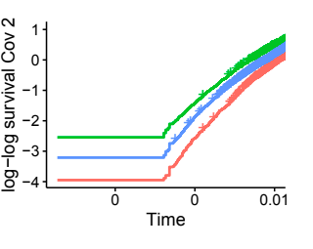
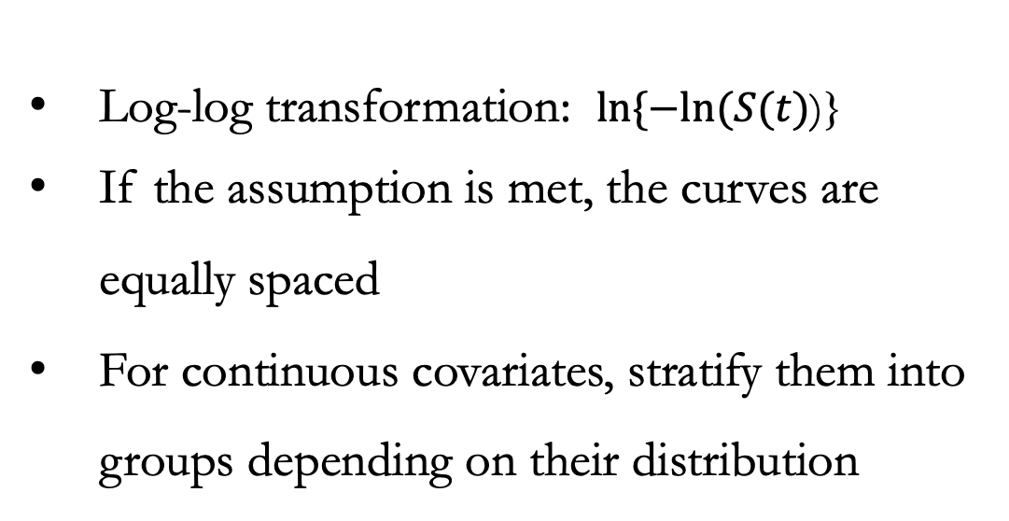
Graphics with survival curves
Log-log transformation: $ln⁡\{−ln⁡(S(t)$)}
If the assumption is met, the curves are equally spaced
For continuous covariates, stratify them into groups depending on their distribution
Notes:
Graphics with survival curves: If the assumption is met, the difference between survival curves is supposed to be linear. Thus, the two curves are approximately parallel. For continuous variables, one can stratify them into different categories and perform the graphical test.

Slide 38
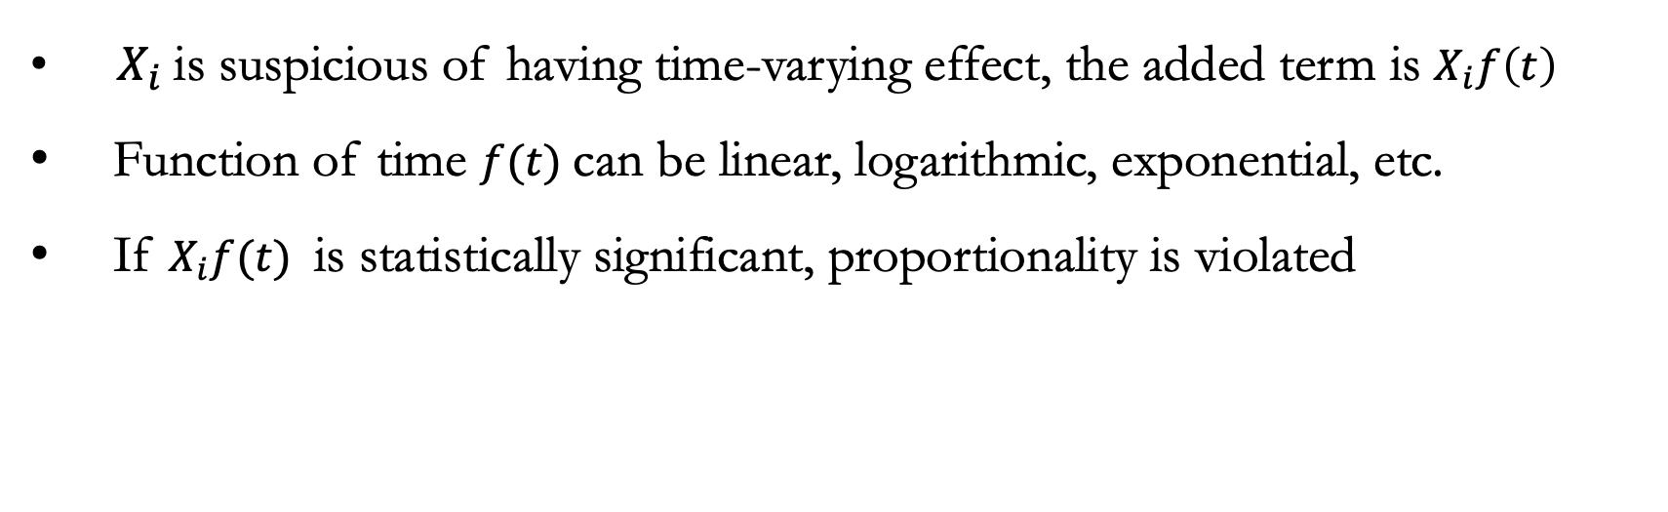
Time-covariate interaction
${ X}_{i}$ is suspicious of having time-varying effect, the added term is $X_{i}f\left(t\right)$
Function of time $f(t)$ can be linear, logarithmic, exponential, etc.
If $X_{i}f(t)$ is statistically significant, proportionality is violated
Notes:
Time-covariate interaction terms (We can test the significance of time-covariate interaction to detect the assumption violation. If $X_{1}$ is suspicious of having time-varying effect, the added term is $X_{1}f(t)$ where f(t) is a function of time. It can be linear, log, exponential, etc.

Slide 39
Goodness-of-fit test
• Formula for Schoenfeld residuals of suspiciously time-varying covariate A:
Schoenfeld residual A = Observed A – Weighted Average A
• If Schoenfeld residuals are correlated with failure times, proportionality is violated
Notes:
Goodness-of-fit test: The goodness-of-fit (GOF) technique tests uses Schoenfeld residuals, which are the difference between the observed and weighted average values of suspiciously time-dependent covariates. If Schoenfeld residuals are correlated with failure times, the proportionality assumption is violated.

Slide 40
Missingness mechanism
Missing not at random (MNAR)
Depend on both observed and unobserved data
Missing completely at random (MCAR)
Depend on unobserved data
Missing at random (MAR)
Not depend on observed or unobserved data
Notes:
Missing Completely At Random (MCAR)
Missing At Random (MAR)
Missing Not At Random (MNAR).
Data is MCAR when the missingness does not depend on observed or unobserved data, MAR when the missingness conditions on unobserved data, and MNAR depends on both observed and unobserved data (Rubin, 1976).
In a longitudinal study, linear mixed-effects models are used to handle incomplete continuous data with repeated measurements. These models work under the assumption that data is missing at random.

Slide 41
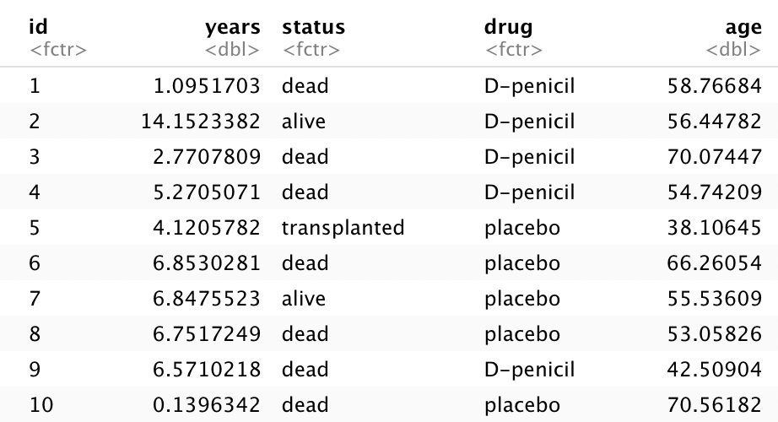
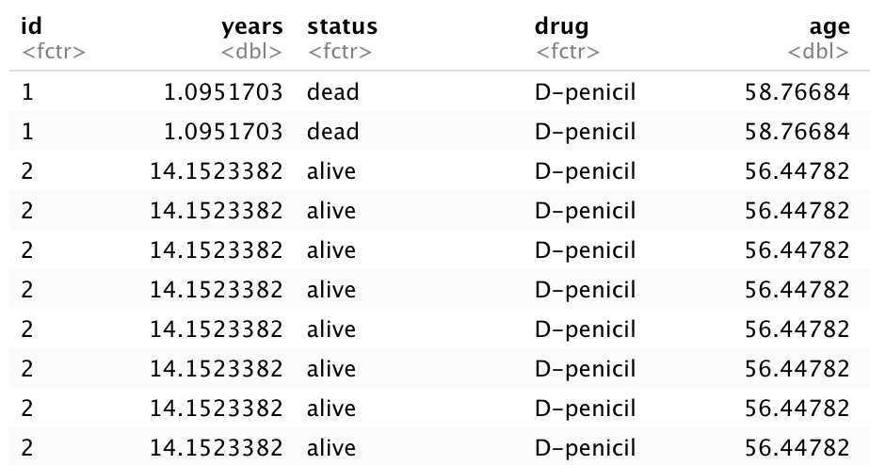
Short data format
Counting Process format
Notes:
Data format for the three models.

Slide 42
Results from Multivariate Analysis
Subsets of significant covariates from variable selection for Cox PH Model
Multivariate Cox PH Model
Characteristic | HR | 95% CI | p-value
bilirubin | 1.11 | (1.06-1.15) | <0.001
albumin | 0.52 | (0.32-0.85) | 0.008
age | 1.04 | (1.03-1.06) | <0.001
edema |  |  | 0.019
no edema | ref
edema no diuretics | 1.04 | (0.65-1.67)
edema diuretics | 2.37 | (1.33-4.22)
histologic |  |  | 0.014
1 | ref
2 | 4.49 | (0.60-33.8)
3 | 5.79 | (0.79-42.5)
4 | 8.04 | (1.09-59.5)
SGOT | 1.00 | (1.00-1.01) | 0.012
prothrombin | 1.46 | (1.20-1.78) | <0.001
Multivariate Time-Dependent Cox Model
HR | 95% CI | p-value
1.20 | (1.17-1.23) | <0.001
0.59 | (0.36-0.97) | 0.036
1.06 | (1.05-1.08) | <0.001
 |  | 0.003
ref
1.18 | (0.72-1.93)
3.09 | (1.66-5.72)
 |  | <0.001
ref
1.97 | (0.26-14.9)
4.48 | (0.61-33.0)
6.69 | (0.90-49.4)
1.00 | (0.99-1.00) | 0.4
1.11 | (0.91-1.36) | 0.3
Survival Submodel of Joint Model
HR | 95% CI | p-value
1.81 | (1.60-2.04) | <0.0001
0.67 | (0.41-1.08) | 0.1011
1.05 | (1.03-1.07) | <0.0001
 |  | 0.0003
ref
1.97 | (1.18-3.30)
3.11 | (1.64-5.89)
 |  | 0.3422
ref
1.72 | (0.26-11.26)
2.02 | (0.31-13.00)
2.58 | (0.40-16.70)
1.00 | (0.99-1.00) | 0.9569
1.22 | (0.99-1.51) | 0.623
Notes:
A multivariate analysis is reconducted with the union of those sets of covariates for each of all three models. The differences among estimated hazard ratios for each model are negligible.

Slide 43
Results from Multivariate Analysis
Subsets of significant covariates from variable selection for Time-Dependent Cox Model
Multivariate Cox PH Model
Characteristic | HR | 95% CI | p-value
bilirubin | 1.15 | (1.11-1.18) | <0.001
albumin | 0.50 | (0.31-0.81) | 0.005
age | 1.04 | (1.02-1.06) | <0.001
edema |  |  | 0.002
no edema | ref
edema no diuretics | 0.97 | (0.60-1.55)
edema diuretics | 2.92 | (1.62-5.27)
histologic |  |  | <0.001
1 | ref
2 | 4.63 | (0.62-34.5)
3 | 6.39 | (0.88-46.7)
4 | 10.9 | (1.49-80.1)
Multivariate Time-Dependent Cox Model
HR | 95% CI | p-value
1.20 | (1.17-1.22) | <0.001
0.62 | (0.38-1.01) | 0.005
1.07 | (1.05-1.09) | <0.001
 |  | 0.001
ref
1.26 | (0.78-2.04)
3.31 | (1.80-6.09)
 |  | <0.001
ref
1.85 | (0.24-14.0)
4.35 | (0.59-32.0)
7.09 | (0.96-52.3)
Survival Submodel of Joint Model
HR | 95% CI | p-value
1.84 | (1.65-2.06) | <0.0001
0.60 | (0.37-0.97) | 0.0364
1.05 | (1.03-1.07) | <0.0001
 |  | <0.0001
ref
2.16 | (1.30-3.59)
3.63 | (1.96-6.70)
 |  | 0.0878
ref
0.92 | (0.21-4.12)
1.23 | (0.28-5.29)
1.70 | (0.39-7.38)
Notes:
A multivariate analysis is reconducted with the union of those sets of covariates for each of all three models. The differences among estimated hazard ratios for each model are negligible.

Slide 44
Results from Multivariate Analysis
Subsets of significant covariates from variable selection for Joint Model
Multivariate Cox PH Model
Characteristic | HR | 95% CI | p-value
bilirubin | 1.14 | (1.11-1.17) | <0.001
albumin | 0.37 | (0.23-0.58) | <0.001
age | 1.04 | (1.03-1.06) | <0.001
edema |  |  | <0.001
no edema | ref
edema no diuretics | 1.01 | (0.63-1.62)
edema diuretics | 3.32 | (1.83-6.01)
Multivariate Cox PH Model
HR | 95% CI | p-value
1.19 | (1.16-1.21) | <0.001
0.47 | (0.29-0.75) | 0.002
1.07 | (1.05-1.09) | <0.001
 |  | <0.001
ref
1.32 | (0.83-2.10)
4.16 | (2.25-7.70)
Survival Submodel of Joint Model
HR | 95% CI | p-value
1.82 | (1.64-2.03) | <0.0001
0.52 | (0.33-0.82) | 0.054
1.05 | (1.04-1.07) | <0.0001
 |  | <0.0001
ref
2.05 | (1.25-3.36)
3.84 | (2.09-7.06)
Notes:
A multivariate analysis is reconducted with the union of those sets of covariates for each of all three models. The differences among estimated hazard ratios for each model are negligible.

Slide 45
Results from Multivariable Analysis
Multivariable Cox PH Model |  |  |  | Multivariable Cox PH Model |  |  | Survival Submodel of Joint Model
Characteristic | HR | 95% CI | p-value | HR | 95% CI | p-value | HR | 95% CI | p-value
bilirubin | 1.11 | (1.06-1.15) | <0.001 | 1.20 | (1.17-1.23) | <0.001 | 1.81 | (1.60-2.04) | <0.0001
bilirubin | 1.15 | (1.11-1.18) | <0.001 | 1.20 | (1.17-1.22) | <0.001 | 1.84 | (1.65-2.06) | <0.0001
bilirubin | 1.14 | (1.11-1.17) | <0.001 | 1.19 | (1.16-1.21) | <0.001 | 1.82 | (1.64-2.03) | <0.0001
Multivariable Analysis - Serum Bilirubin
Model | Hazard Ratios | 95% Confidence Interval | p-value
Model 1: Cox PH | 1.11 | (1.06 – 1.15) | <0.001
Model 2: Time-Dependent Cox | 1.20 | (1.17 – 1.22) | <0.001
Model 3: Joint Model | 1.82 | (1.64 - 2.03) | <0.0001
Notes:
A multivariate analysis is reconducted with the union of those sets of covariates for each of all three models. The differences among estimated hazard ratios for each model are negligible.

Slide 46
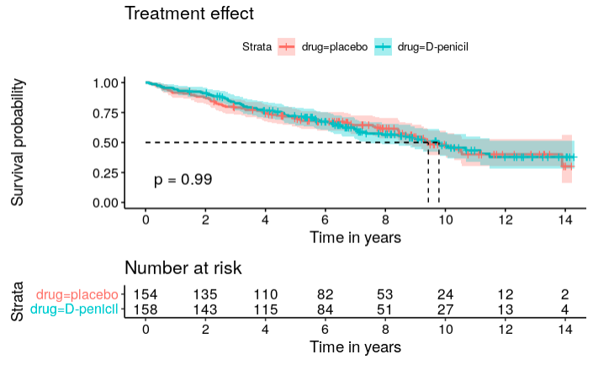
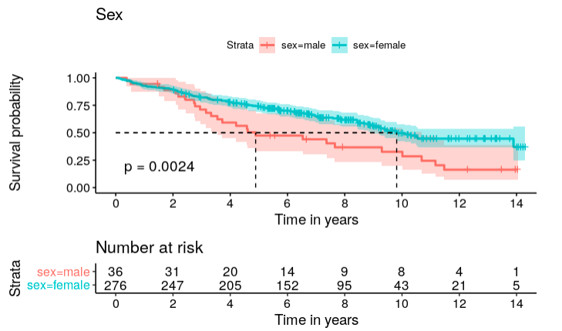
Treatment effect
Sex
Drug
Female
Treatment
Male
Notes:
Survival probability seems roughly similar between placebo and treatment groups in the plot. Females have higher survival probability than males generally. The log-rank based test for survivorship between groups also confirms the observation. P-value of 0.99 indicates that drug is not significant. P-value 0.0024 indicates that sex is statistically significant.

Slide 47
Log-rank based test for difference in survivorship between groups
Treatment effect
Sex
Drug
Female
Treatment
Male
Drug is not statistically significant
Sex is statistically significant
Notes:
Survival probability seems roughly similar between placebo and treatment groups in the plot. Females have higher survival probability than males generally. The log-rank based test for survivorship between groups also confirms the observation. P-value of 0.99 indicates that drug is not significant. P-value 0.0024 indicates that sex is statistically significant.

Slide 48
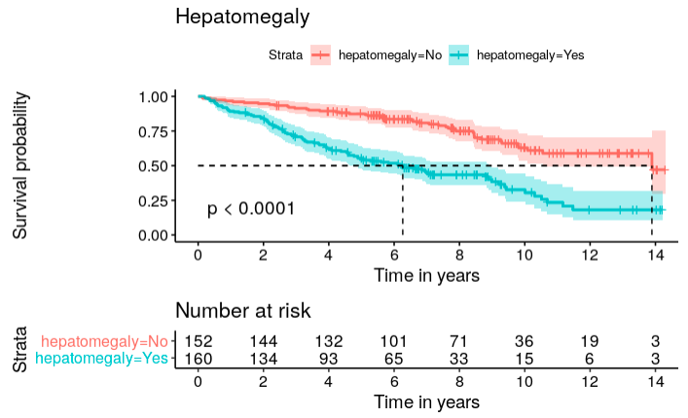
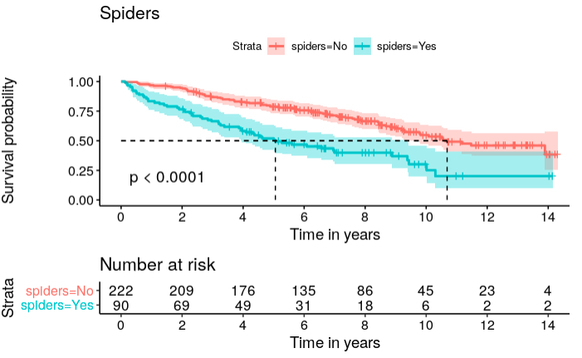
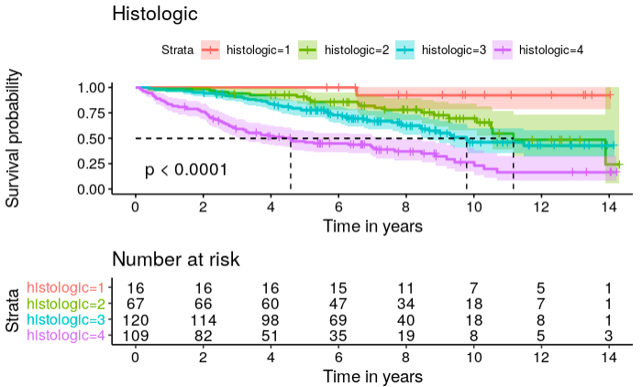
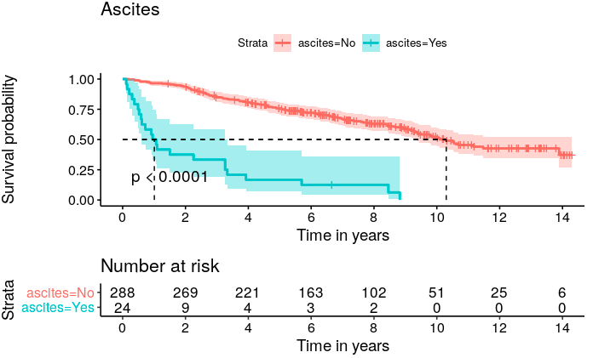
Kaplan-Meier Curves

Slide 49
Joint Model
Longitudinal sub-model: Linear Mixed-Effect model
Response: Longitudinal bilirubin
Predictors: sex and baseline covariates for ascites, hepatomegaly, spiders, albumin, alkaline, SGOT, and prothrombin
Random Effect: visit-time | id
Bilirubin varies among patients and changes dynamically within individuals
Survival sub-model: Cox PH model
Response: survival
Covariates: baseline values for albumin, edema, and age

Slide 50
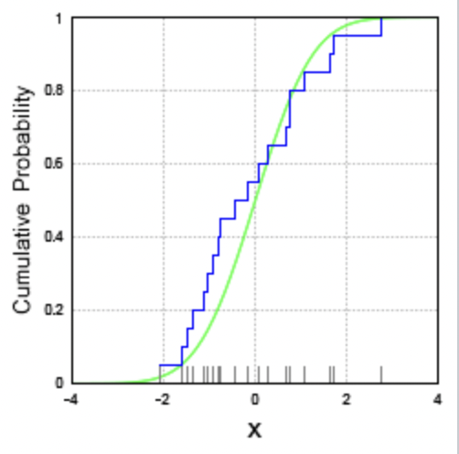

Empirical CDF
Formula:
${\hat{F}}_{n}\left(t\right)= \frac{1}{n}\sum_{i=1}^{n}{I\left(X_{i}≤t\right)}$
Indicator $I\left(X_{i} ≤t\right)$ is a
Bernoulli R.V. with $p=F(t)$
Without censoring:
${\hat{F}}_{n}\left(t\right)=1 −S(t)$
Source: Wikipedia
Notes:
If there’s no censoring and no competing risks, the empirical cumulative distribution function is identical to the cumulative incidence function. (And both are equal to 1 minus the survivor function). Otherwise, they are not the same.
The green curve is the true cumulative distribution function of the standard normal distribution. (The grey hash marks represent the observations in a particular sample drawn from that distribution), and the horizontal steps of the blue step function form the empirical distribution function of that sample.

Slide 51
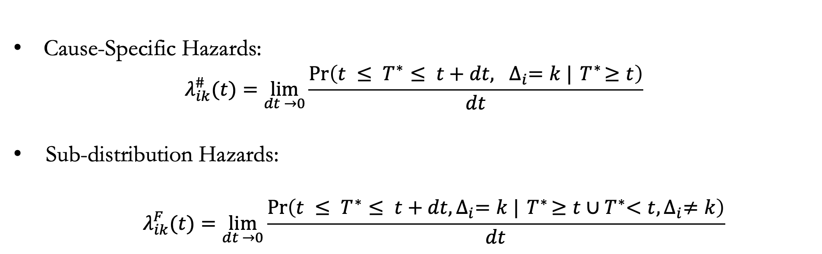
Competing Risks Framework
Cause-Specific Hazards:
$$λ_{ik}^{\#}(t)=\lim_{dt →0}{\frac{\operatorname{Pr}\left({t ≤ T}^{∗}≤ t+dt, ∆_{i}=k |{ T}^{∗}≥t\right)}{dt}}$$
Sub-distribution Hazards:
$$λ_{ik}^{F}(t)=\lim_{dt →0}{\frac{\operatorname{Pr}\left({t ≤ T}^{∗}≤ t+dt,∆_{i}=k |{ T}^{∗}≥t∪{ T}^{∗}<t,∆_{i}≠k\right)}{dt}}$$

Slide 52
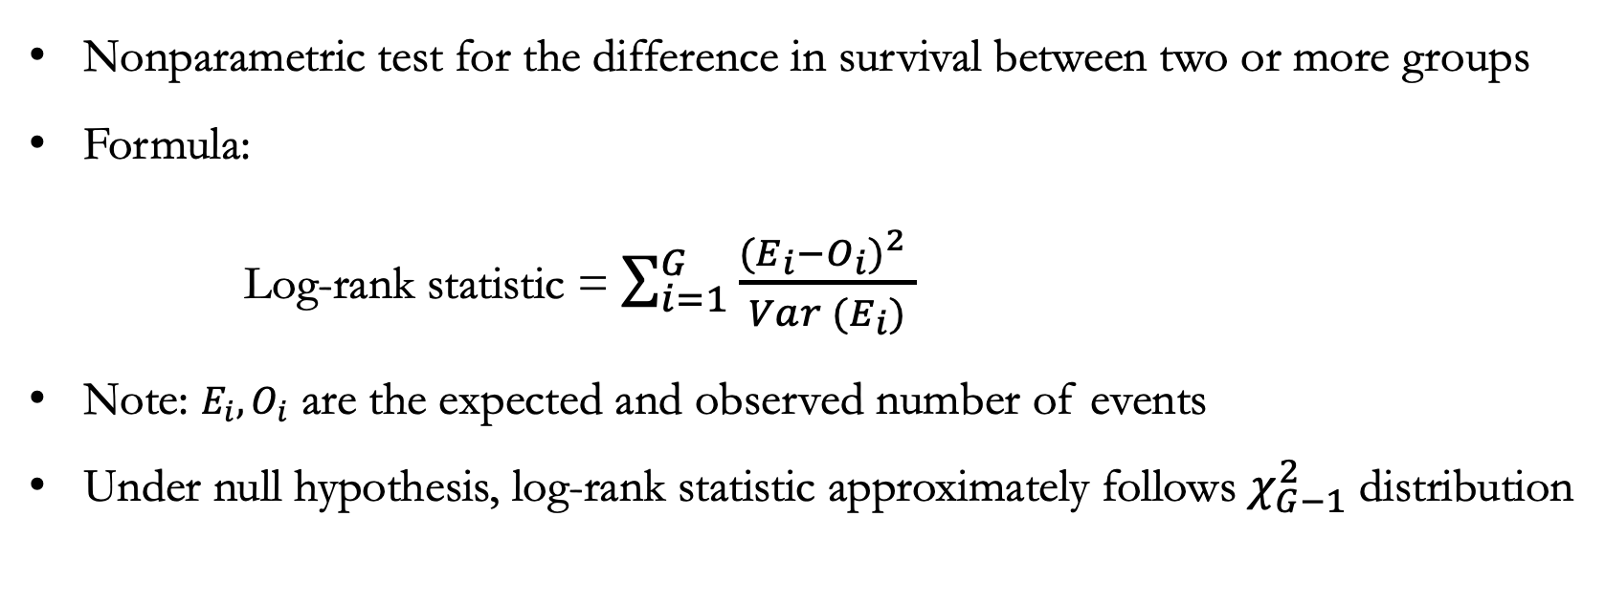
Log-rank based test
Nonparametric test for the difference in survival between two or more groups
Formula:
Log-rank statistic = $\sum_{i=1}^{G}{\frac{{(E_{i}−O_{i})}^{2} }{Var (E_{i})}}$
Note: $E_{i}{, O}_{i}$ are the expected and observed number of events
Under null hypothesis, log-rank statistic approximately follows $χ_{G−1}^{2}$ distribution
Notes:
The null hypothesis is that there is no difference among the survival of the groups while the alternative hypothesis states that there is.
Under this null hypothesis, the log–rank statistic approximately follows chi-square distribution.
(need the observed and expected number of events at each event time. The observed are from the sample and the expected are computed assuming that the survival curves are identical)
To generate the expected numbers of events we estimate the proportion of events that occur at each time using data from both groups combined. We multiply these estimates by the number of subjects at risk at that time in each groups.

